Slide 1
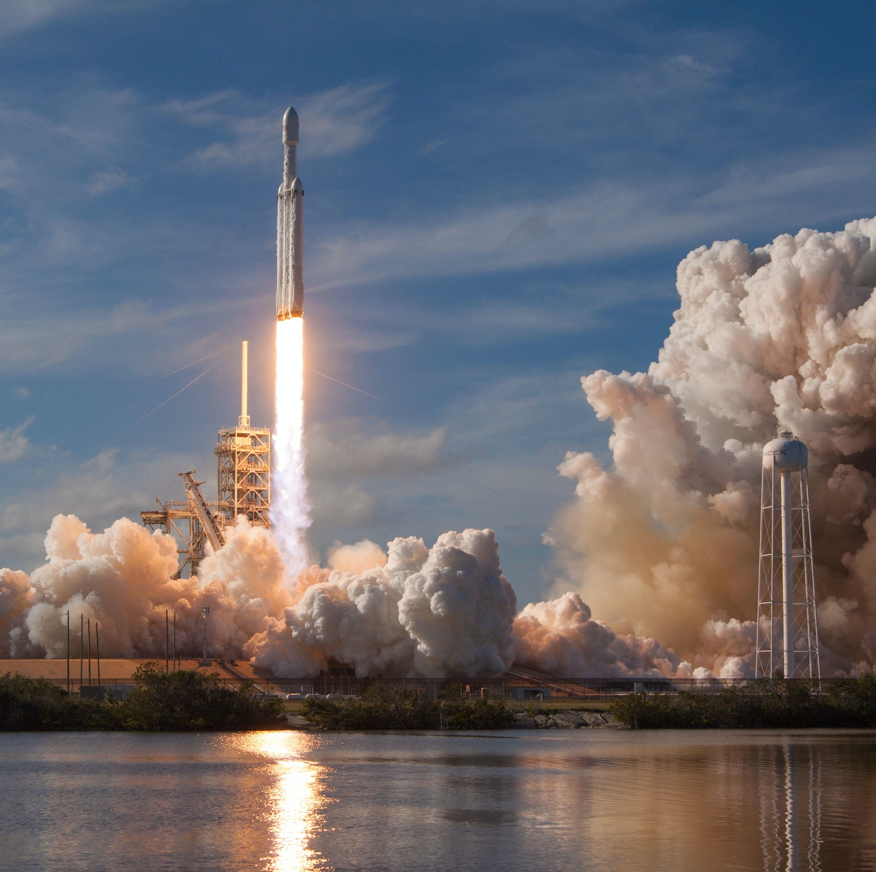
Applied Data Science Capstone Project
- Manoj V
22.04.2023

Slide 2

Outline
• Executive Summary
• Introduction
• Methodology
• Results
• Conclusion

Slide 3

Executive Summary
Following methodologies were used for data analysis:
Data Collection using web scrapping and Data Wrangling.
Exploratory Data Analysis (EDA) with SQL, Data Visualization and interactive dashboard analytics.
Interactive dashboard results
Machine Learning Predictions based on standardized data.

Slide 4

Introduction
Objective: To conduct a comprehensive analysis and assess the success rate of first stage landing of a novel company SpaceY in comparison to SpaceX.
Desirable Outcomes:
The effects of features such as Payload Mass, Launch Site, Orbit on the success of first stage landing
Presentation of success rate results over the years.
A highly accurate prediction model for the success rate based on Machine Learning

Slide 5

Methodology
• Data Collection: Data was primarily collected from sources below
Sources:
SpaceX API (https://api.spacexdata.com/v4/launches/past)
Web scrapping (Wiki Link)
• Data Wrangling
Data was labelled based on the outcome of the launch, making it easier to work on in EDA

Slide 6
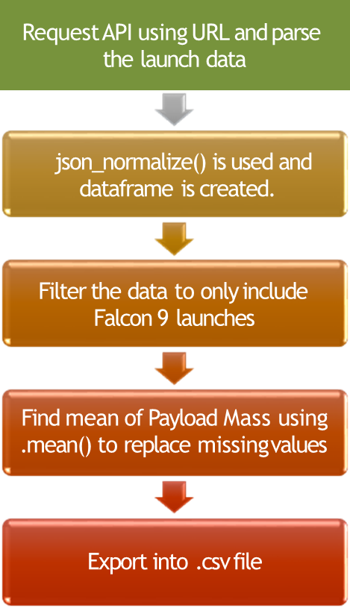
Data Collection - API

Slide 7
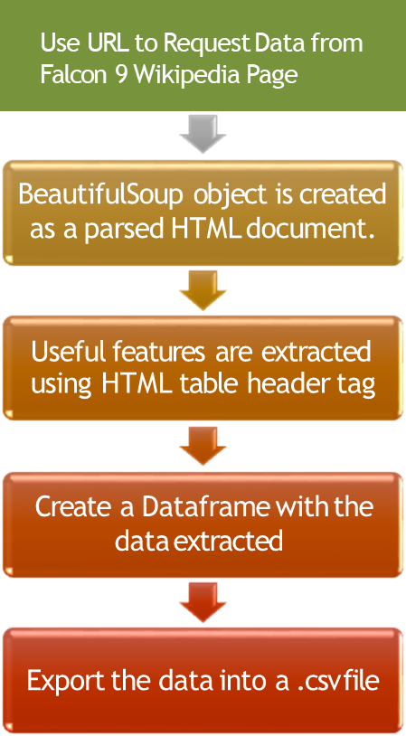
Data Collection – Web Scrapping

Slide 8
Exploratory Data Analysis (EDA) with SQL
The following SQL queries were performed to extract valuable data:
1. Display the names of the unique launch sites in the space mission
2. Display 5 records where launch sites begin with the string 'CCA'
3. Display the total payload mass carried by boosters launched by NASA (CRS)
4. Display average payload mass carried by booster version F9 v1.1
5. List the date when the first successful landing outcome in ground pad was achieved.
6. List of names of boosters that succeeded and have payload mass between 4000-6000.
7. List the total number of successful and failure mission outcomes
8. List the names of booster versions that carried a max payload mass using Subquery.
9. List the records which will display the month names, failure landing outcomes in drone ship ,booster versions, launch site for the months in year 2015.
10. Rank the count of successful landing outcomes between the date 04-06-2010 and 20-03-2017 in descending order

Slide 9
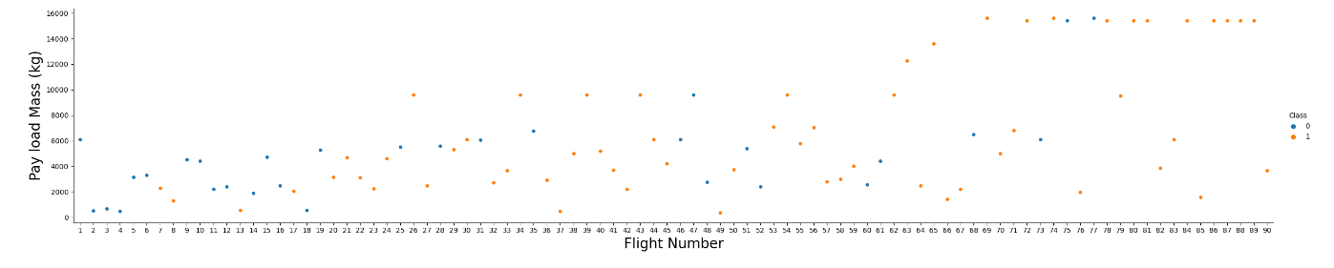
EDA with Data Visualization
1. Scatter Plot: Payload Mass vs Flight Number

Slide 10
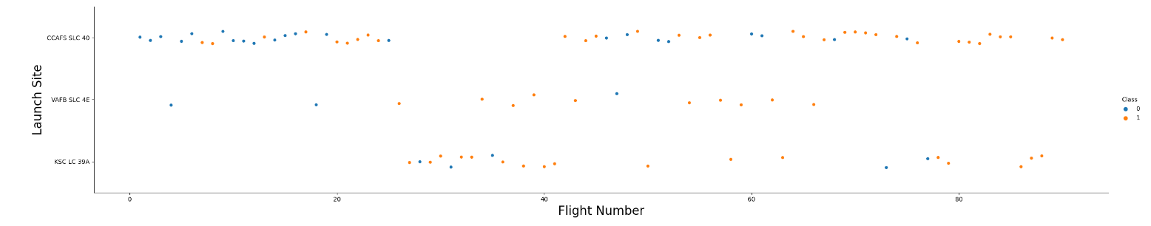
EDA with Data Visualization
2. Scatter Plot: Launch Site vs Flight Number

Slide 11
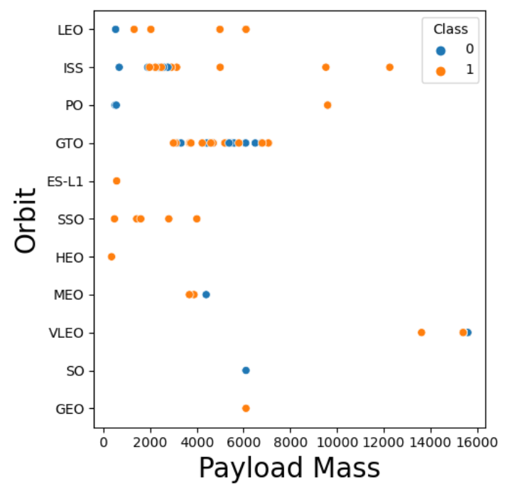
EDA with Data Visualization
https://github.com/Rambo1806/IBM-Data-Science-Capstone/blob/main/EDA%20Visualization.ipynb
Visit Link for more clear Pictures and Details

Slide 12

Interactive Mapping with Folium
Folium enables interactive analysis enables the use of multiple leaflet maps and used in dashboarding.
The following functions of folium were used along with Folium Library:
1. Markers: Used to mark coordinates of the data in a real-world map (e.g. launch sites )
2. Circles: Provides a circular highlight to the markers' specific location (SpaceX launch site)
3. Marker Clusters provide the option to mark as a group of occurrences in each coordinate. (e.g., multiple launches at a launch site).
4. Plotting line between two points provides distance between those coordinates.

Slide 13
Dashboarding with Plotly
The following 2 plots were used to encapsulate and visualize data using an interactive dashboard:
1. Pie chart of Percentages of Launches by sites based on the choice of the dropdown menu.
2. A scatter plot to show relation between payload and Launch success. The payload range (Kg) is inputted using an interactive slider as shown in the source code.
The key idea is to understand the relation between payload and launch success to pick the best launch site to have a first stage success.

Slide 14
Predictive Analysis (Classification)
The four classification models are:
1. Logisitic Regression
2. Support Vector Machines
3. Decision Tree
4. K nearest Neighbours

Slide 15
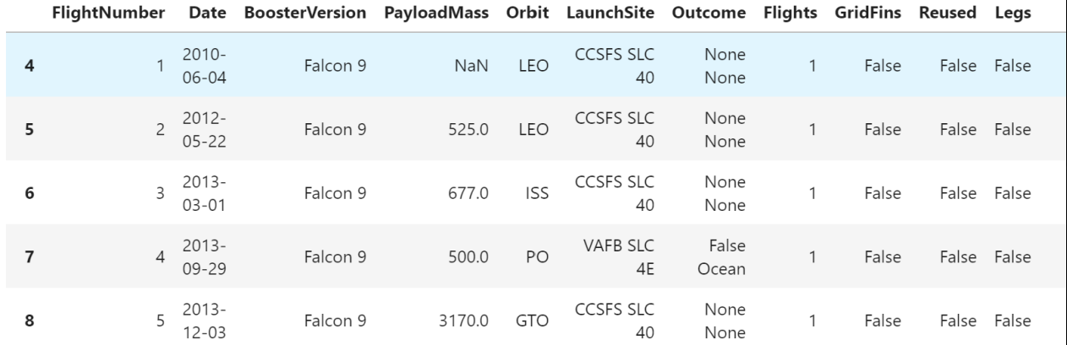
Results – Data Collection API
Data collected from the SpaceX API that only contains information pertaining to Falcon 9 Booster Version

Slide 16
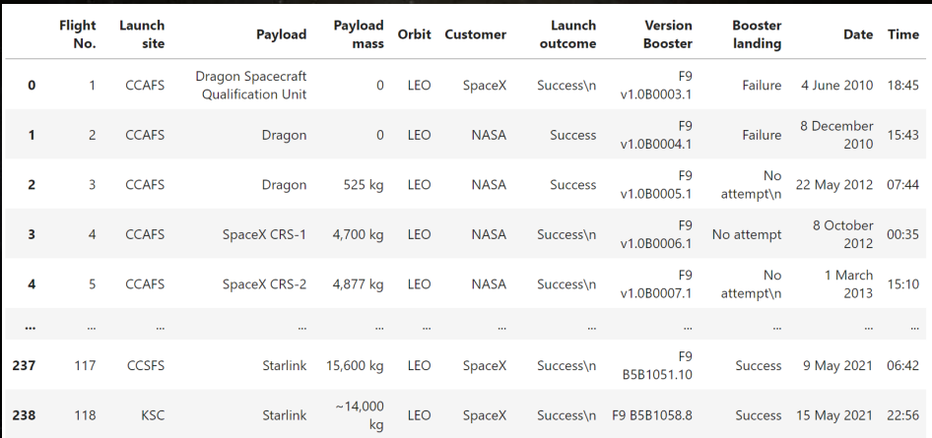
Results – Data Collection Web scrapping
Data collected from Wikipedia in reference to SpaceX and entered as a data frame using Pandas

Slide 17
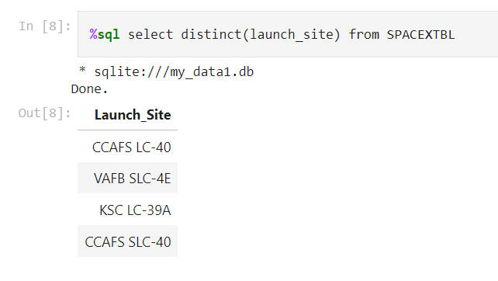
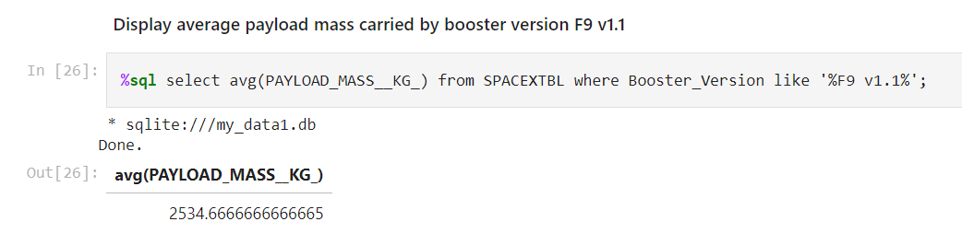
Results – EDA with SQL
https://github.com/Rambo1806/IBM-Data-Science-Capstone/blob/main/SQL%20EDA.ipynb
Visit Link for further Details and Results

Slide 18
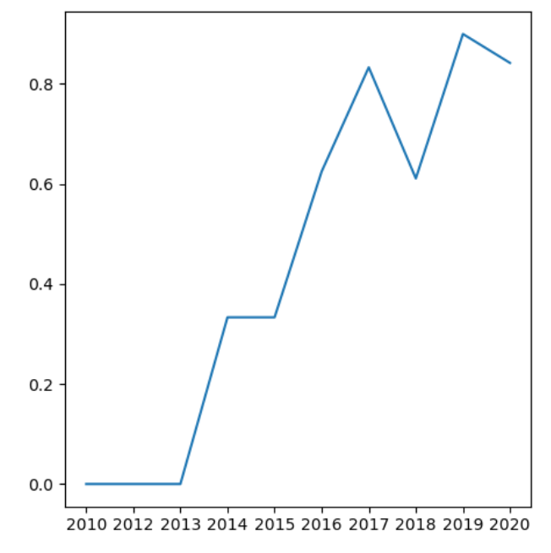
Results – EDA with Visualization
https://github.com/Rambo1806/IBM-Data-Science-Capstone/blob/main/EDA%20Visualization.ipynb
Visit Link for further Details and Results
Success rate graph over the years

Slide 19
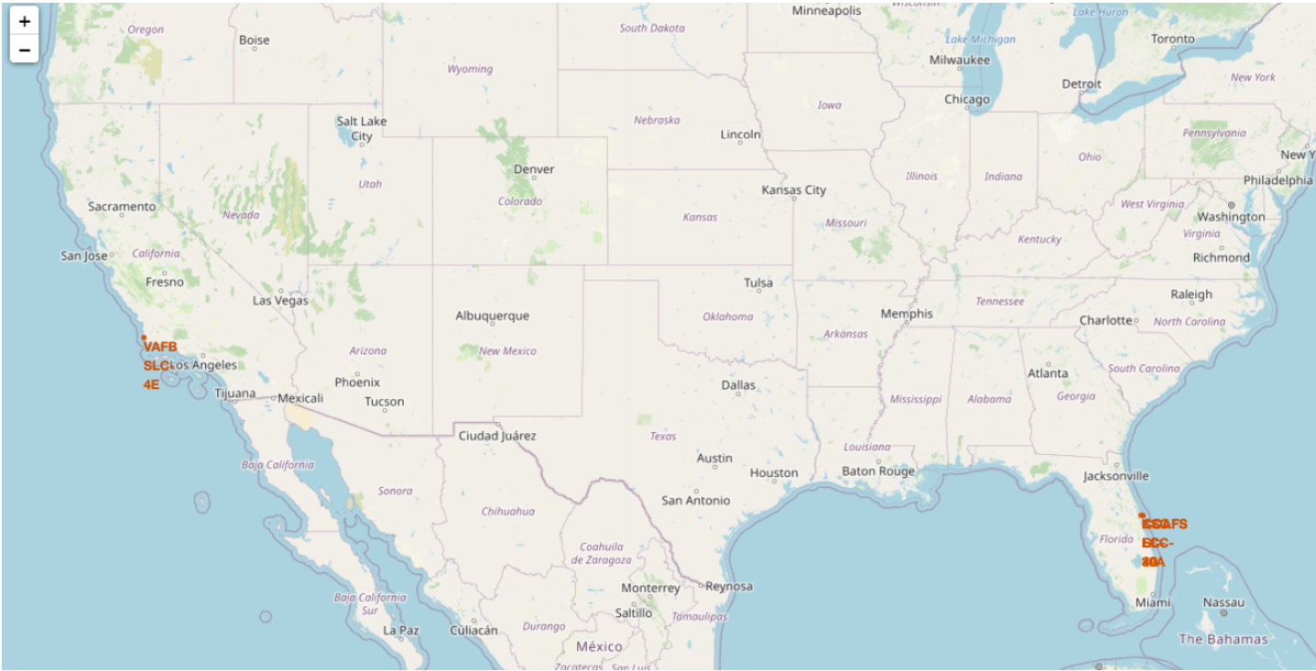
Results – Folium
https://github.com/Rambo1806/IBM-Data-Science-Capstone/blob/main/Folium%20Lab.ipynb
Visit Link for further Details and Results
Launch Sites on Map

Slide 20
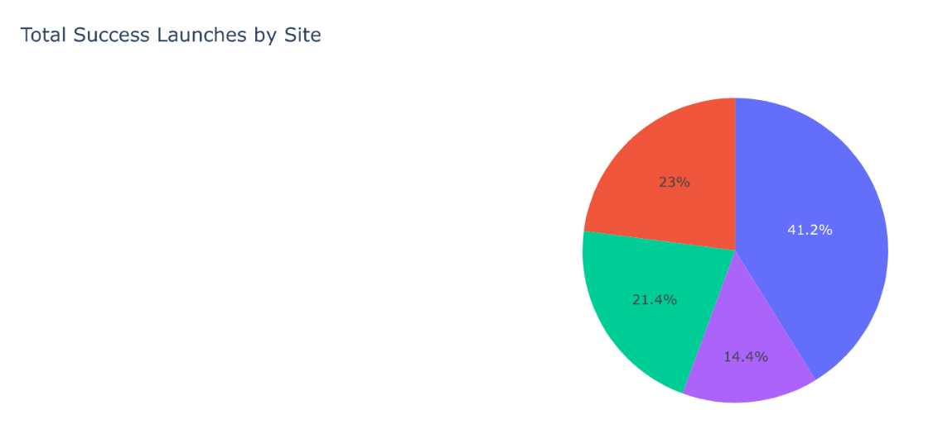
Results – Plotly Dashboard
https://github.com/Rambo1806/IBM-Data-Science-Capstone/blob/main/Plotly%20Application.pdf
Visit Link for further Details and Results

Slide 21
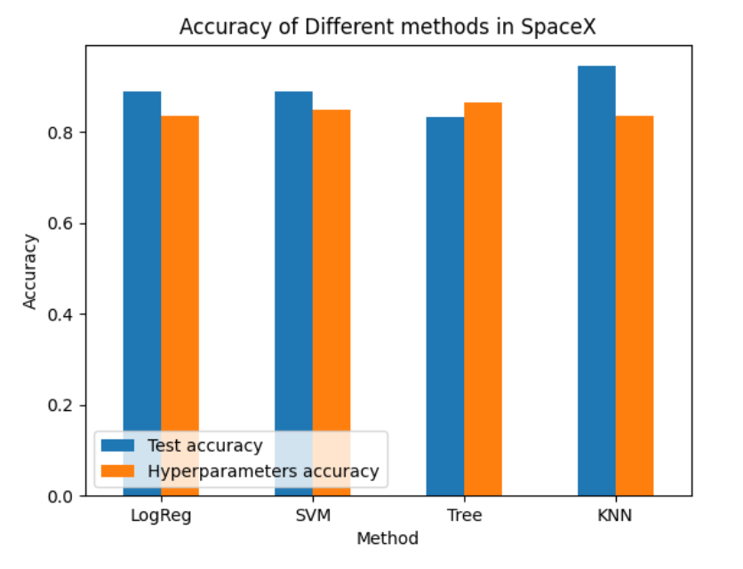
Results – ML Predictive Analysis
https://github.com/Rambo1806/IBM-Data-Science-Capstone/blob/main/Machine%20Learning%20Prediction.ipynb
Visit Link for further Details and Results

Slide 22
Key Conclusions
Orbit Type "ES-L1", "GEO", "HEO" , "SSO", "VLEO" all have a success rate of 100% of landing the first stage rocket.
• The success rates have increased over the years with 2019 having the highest success rate of 98%.
• The launch site with most success is "KSC LC-39A"
• All the launch sites are situated closed to coastlines, to avoid rockets landing on land.
• The ML prediction models provides high accuracy to the datasets with Decision Trees methodology providing highest accuracy.
• The highest success rates come from payload mass range from 2000-5000 Kgs

Slide 23
Thank You
GitHub Repository:
https://github.com/Rambo1806/IBM-Data-Science-Capstone

